Slide 1
Exp. 6
Thermodynamics of the Dissolution of Borax
Data Summary
General Chemistry Experiment I

Slide 2
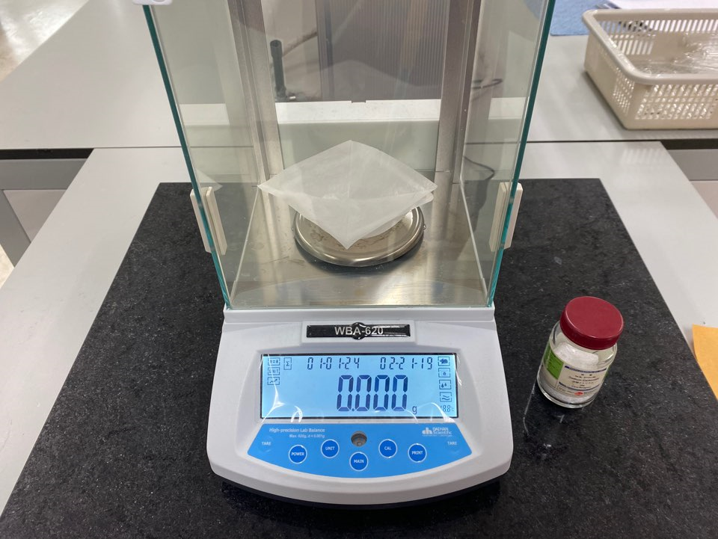
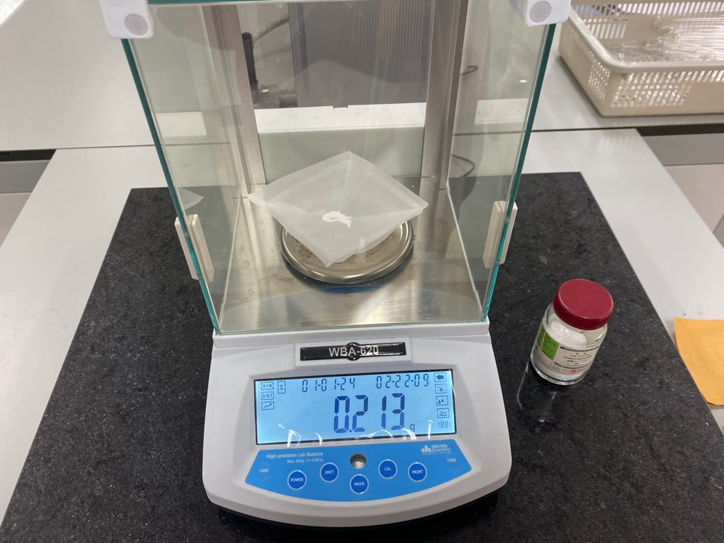
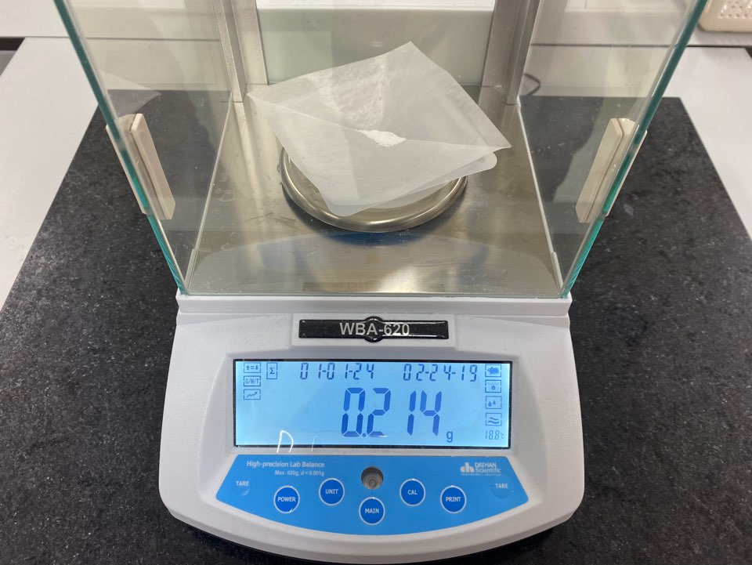
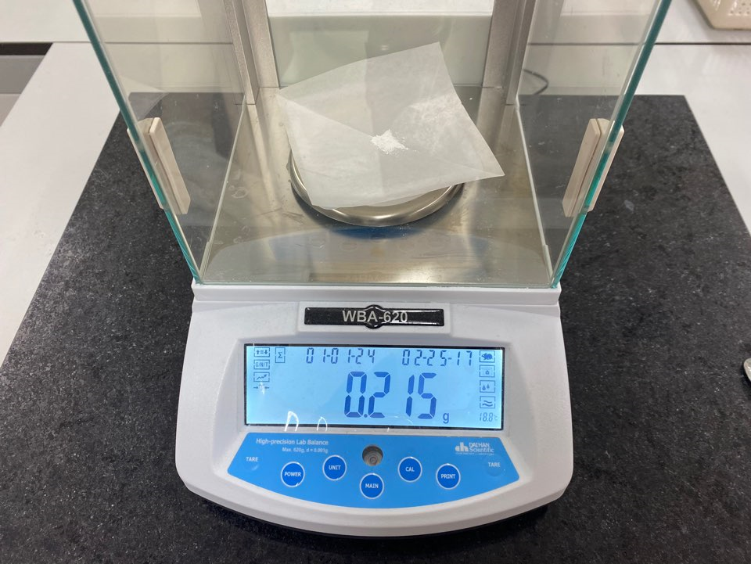
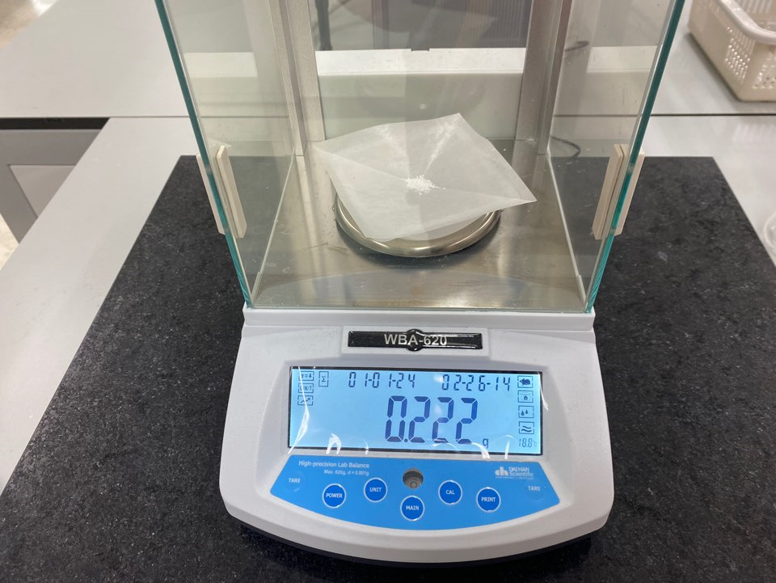
EXPERIMENTAL PROCEDURE & RESULT VIDEOS
Thermodynamics of the Dissolution of Borax
Standardization of HCl Solution
2. Prepare the primary standard.
Calculate the mass of sodium carbonate that neutralizes 20 mL of 0.20 M HCl at the stoichiometric point. Measure this mass on a tared piece of weighing paper or dish.
Trial 1 Trial 2 Trial 3 Trial 4

Slide 3
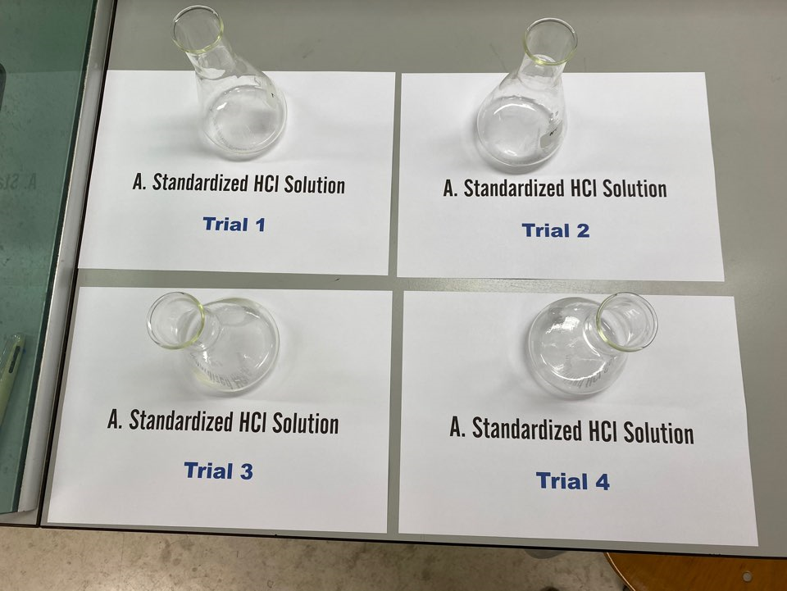
EXPERIMENTAL PROCEDURE & RESULT VIDEOS
Thermodynamics of the Dissolution of Borax
Standardization of HCl Solution
2. Prepare the primary standard.
Transfer sodium carbonate to a 125 mL Erlenmeyer flask.
Prepare at least three samples of sodium carbonate for the analysis of the HCl solution.

Slide 4
EXPERIMENTAL PROCEDURE & RESULT VIDEOS
Thermodynamics of the Dissolution of Borax
Standardization of HCl Solution
3. Prepare the buret.
Clean a buret.
With the stopcock closed, add some distilled water to the buret and make sure the water contacts all the inside part of the buret.
Open the stopcock and let the water drain.
Close the stopcock again and add 3-5 mL of solution. Tip the buret so that the inside of the buret can be rinsed with the solution.
Drain the solution.
Repeat ③-④ few times.

Slide 5
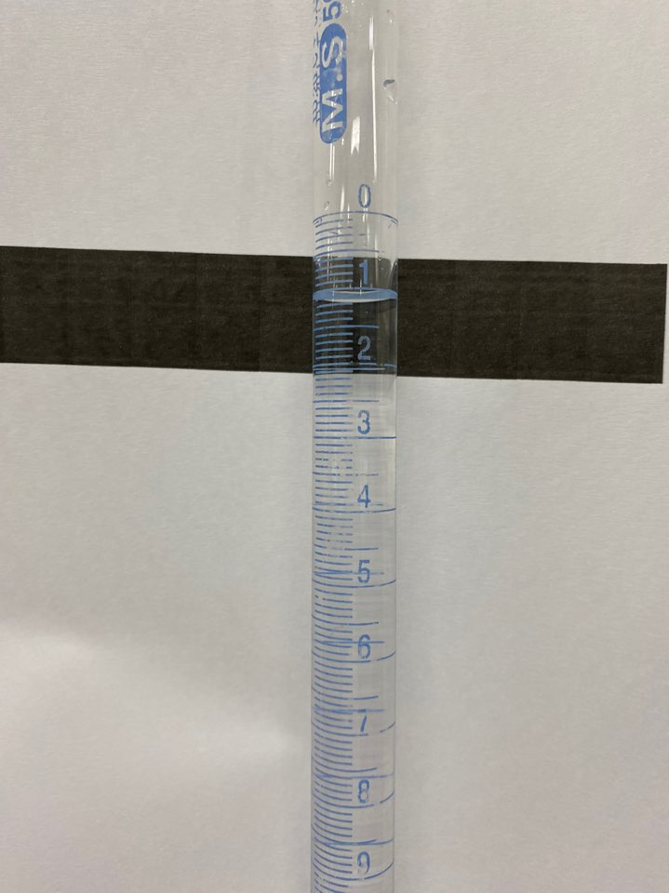
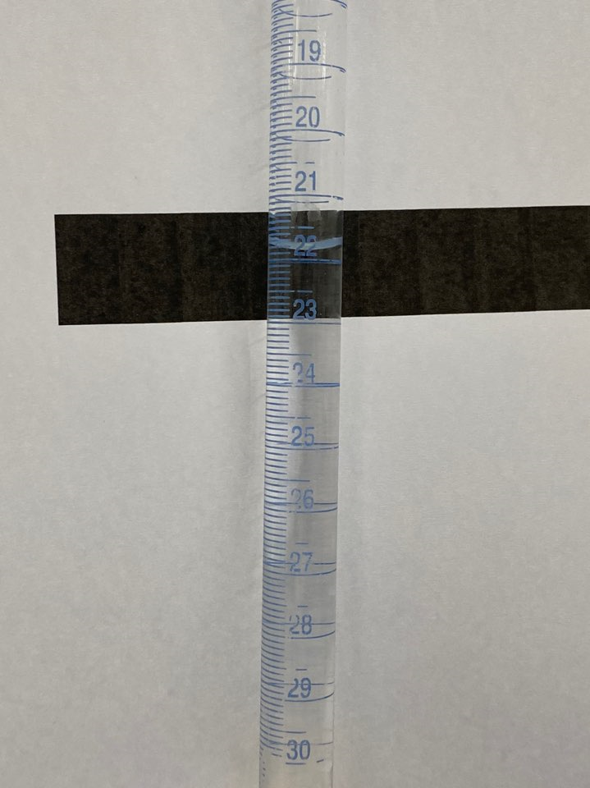
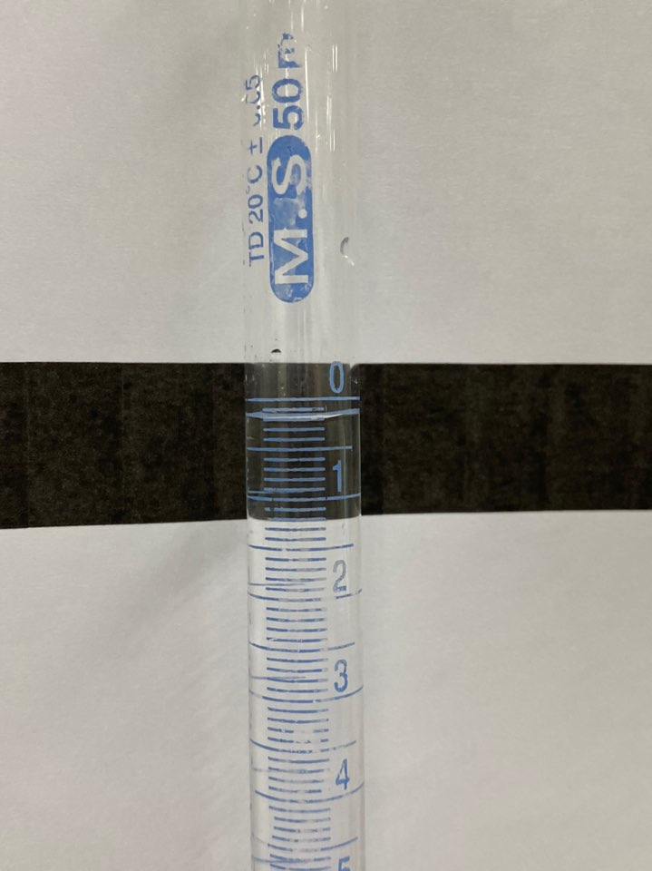
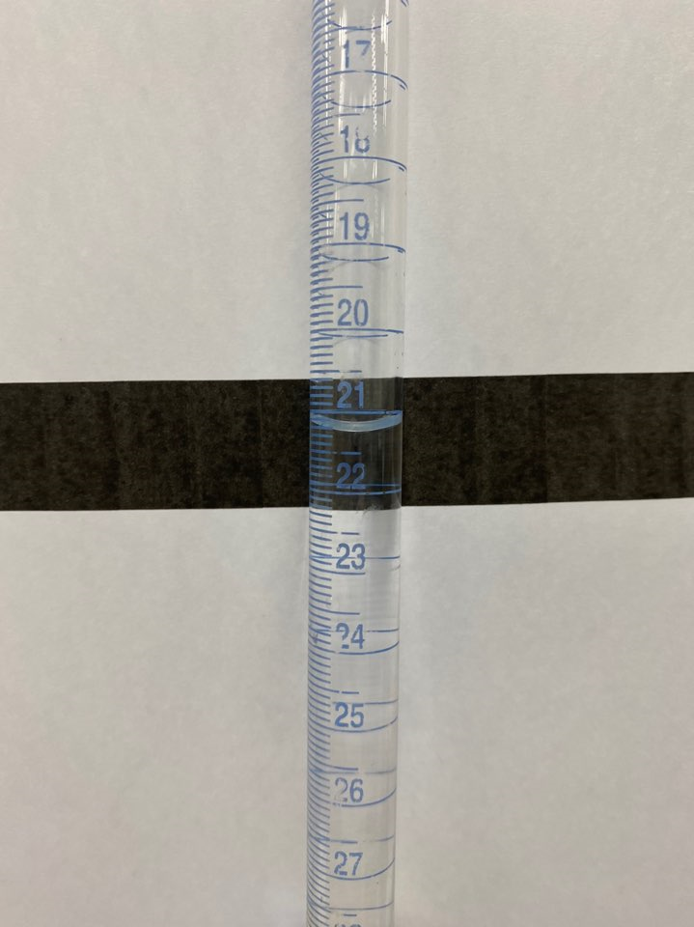
EXPERIMENTAL PROCEDURE & RESULT VIDEOS
Thermodynamics of the Dissolution of Borax
Standardization of HCl Solution
Buret Reading, Initial & Final (mL)
Trial 1
Trial 2

Slide 6
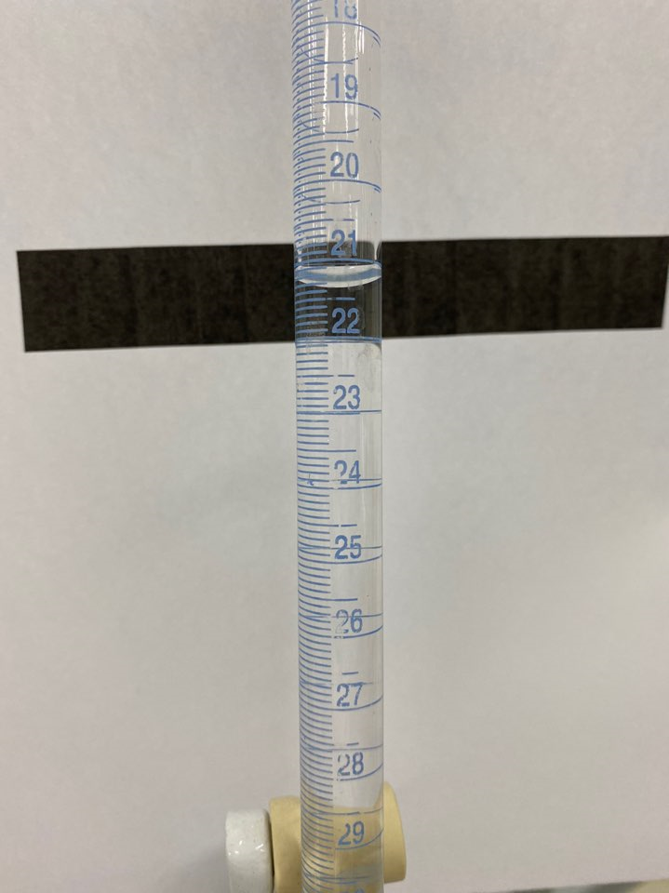
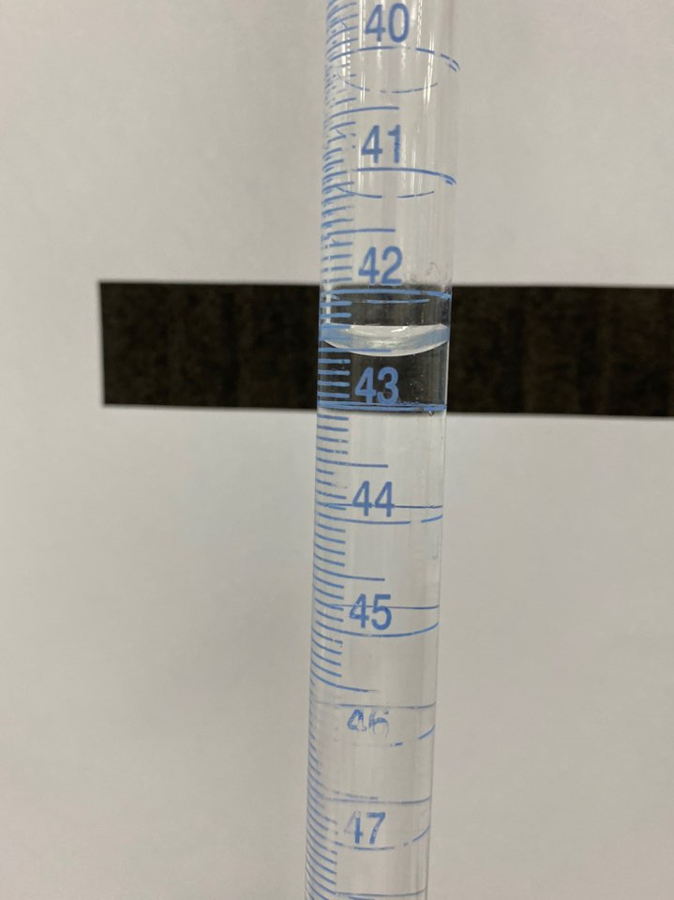
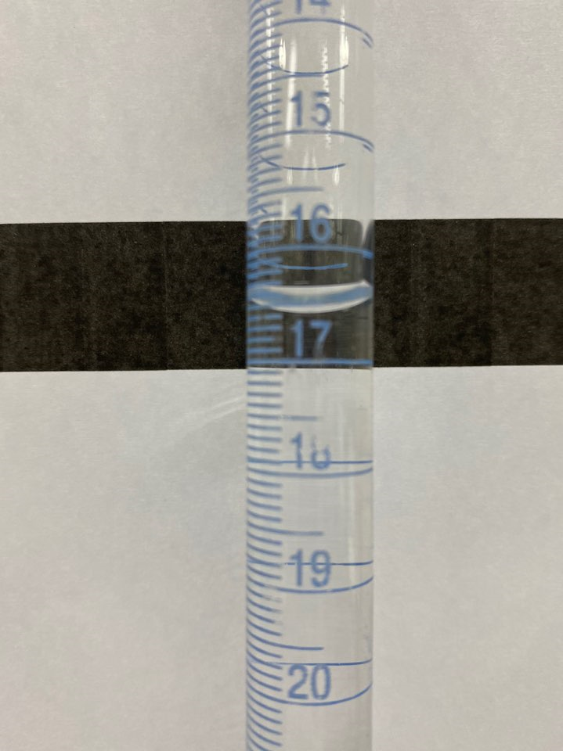
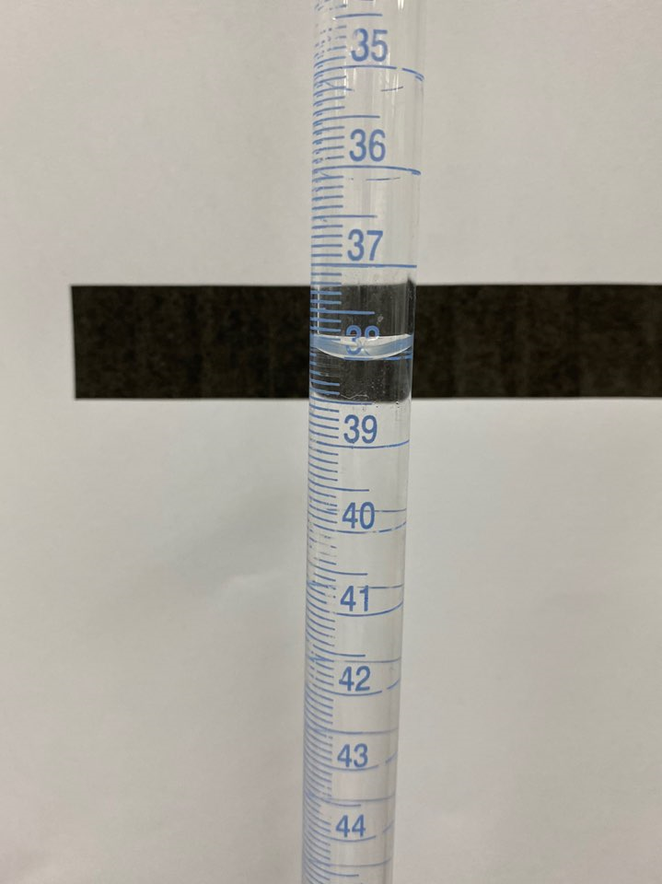
EXPERIMENTAL PROCEDURE & RESULT VIDEOS
Thermodynamics of the Dissolution of Borax
Standardization of HCl Solution
Buret Reading, Initial & Final (mL)
Trial 3
Trial 4

Slide 7
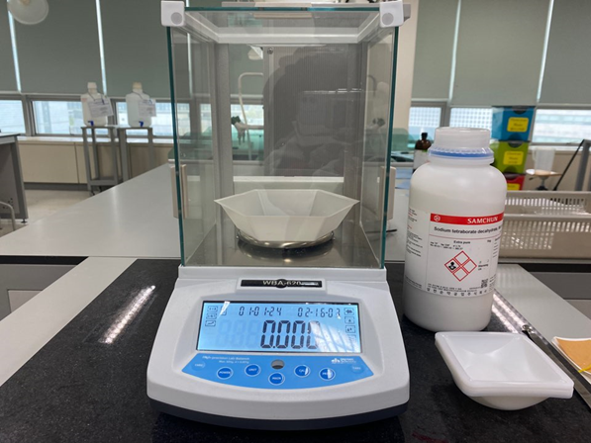
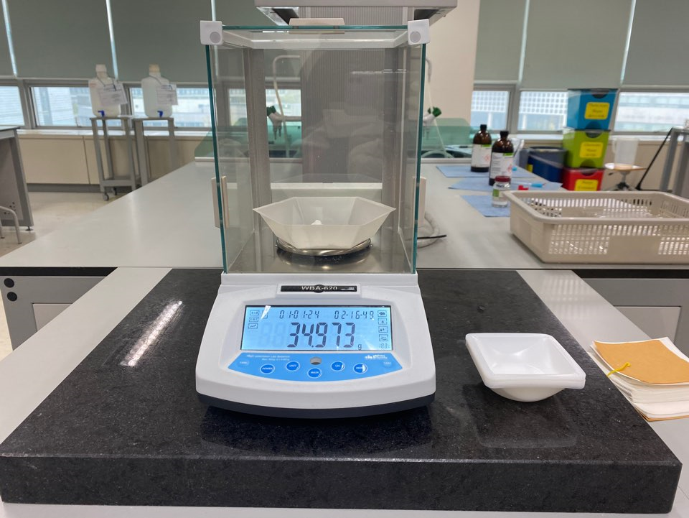
EXPERIMENTAL PROCEDURE & RESULT VIDEOS
Thermodynamics of the Dissolution of Borax
Preparation of Borax Solutions
1. Prepare stock solution of borax.
Use a 250 mL Erlenmeyer flask, add 35 g of borax to 100 mL of deionized water. Agitate the mixture for several minutes to prepare the saturated solution.

Slide 8
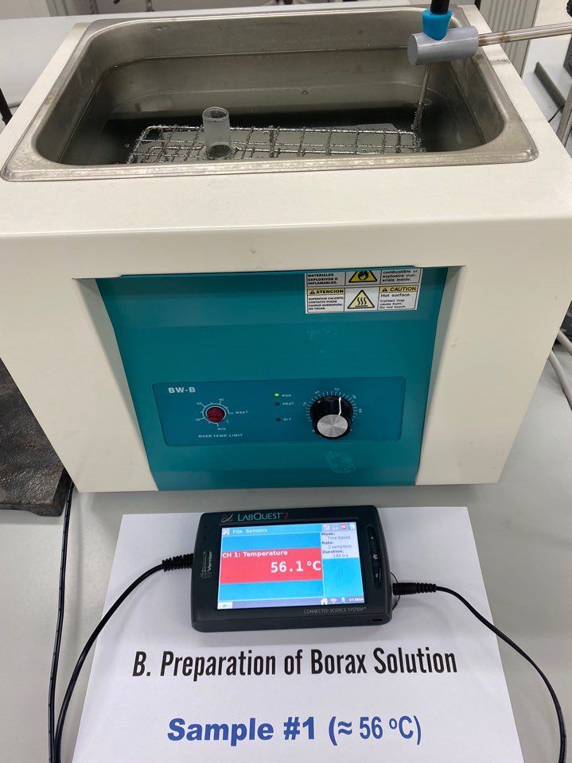
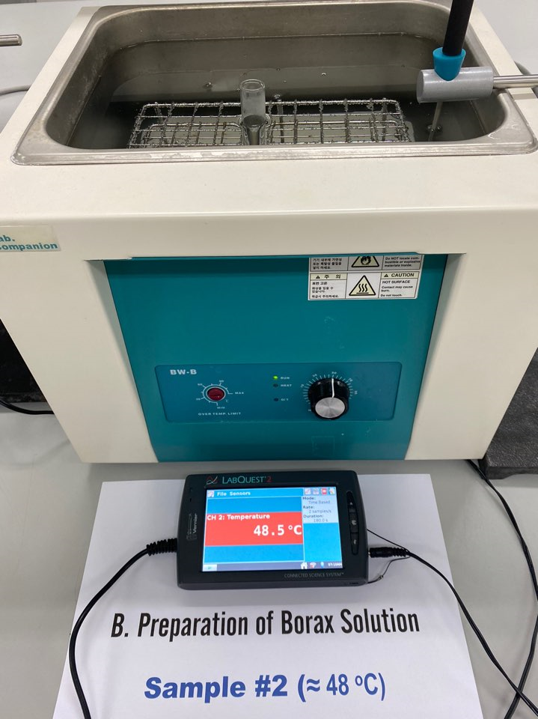
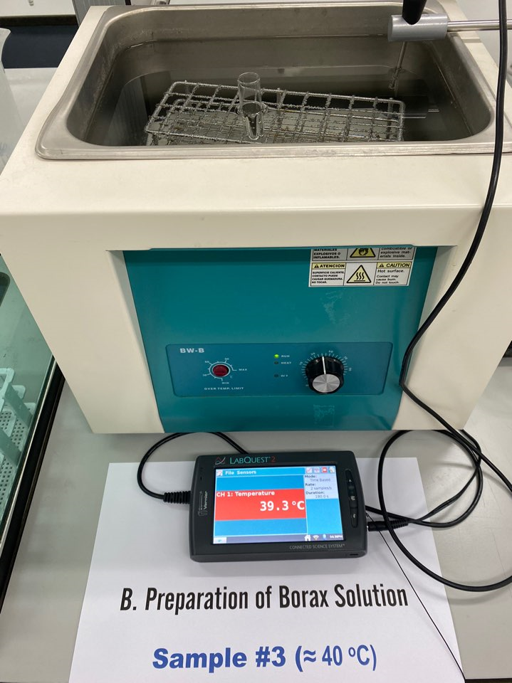
EXPERIMENTAL PROCEDURE & RESULT VIDEOS
Thermodynamics of the Dissolution of Borax
Preparation of Borax Solutions
2. Prepare the test solutions of borax.
Place the test tubes in the respective baths (Sample 1 ≈ 56 °C, Sample 2 ≈ 48 °C, Sample 3 ≈ 40 °C, Sample 4 ≈ 32 °C, Sample 5: Ambient, Sample 6 ≈ 5 °C).

Slide 9
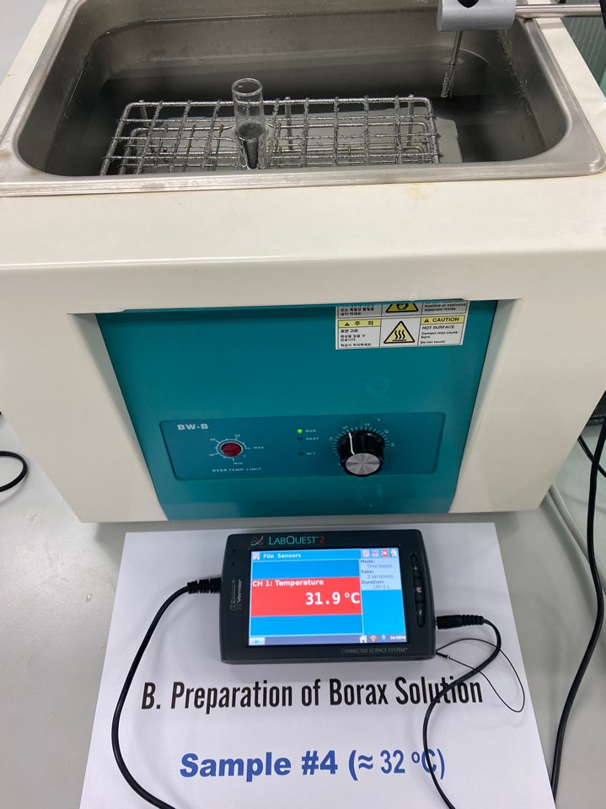
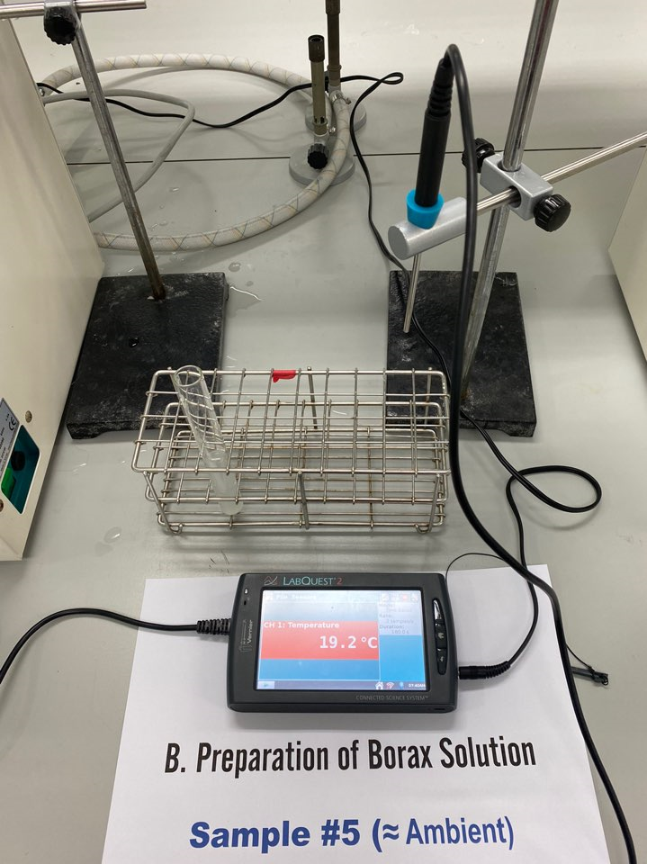
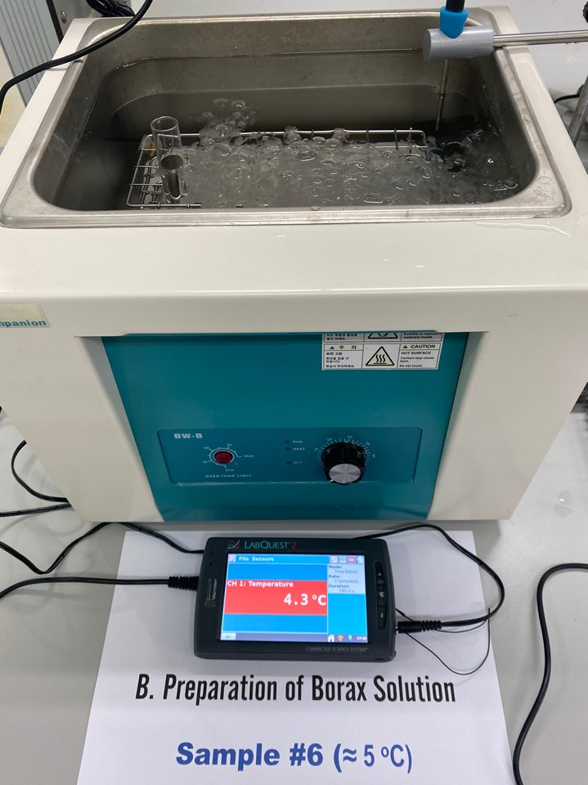
EXPERIMENTAL PROCEDURE & RESULT VIDEOS
Thermodynamics of the Dissolution of Borax
Preparation of Borax Solutions
2. Prepare the test solutions of borax.
Place the test tubes in the respective baths (Sample 1 ≈ 56 °C, Sample 2 ≈ 48 °C, Sample 3 ≈ 40 °C, Sample 4 ≈ 32 °C, Sample 5: Ambient, Sample 6 ≈ 5 °C).

Slide 10
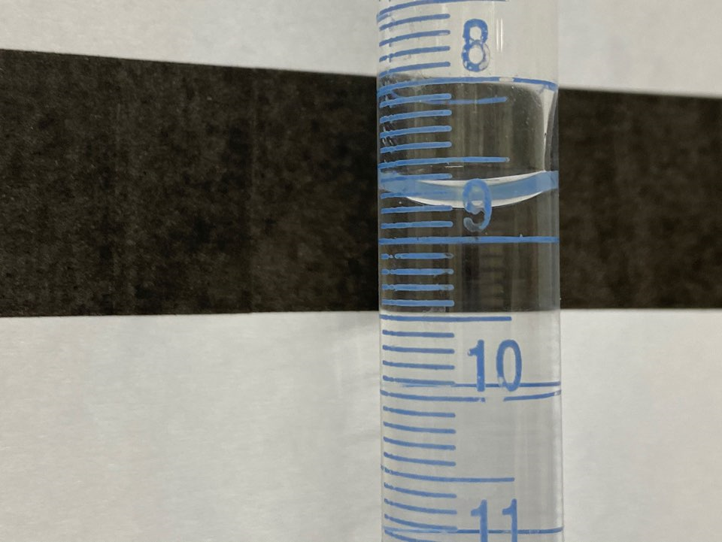
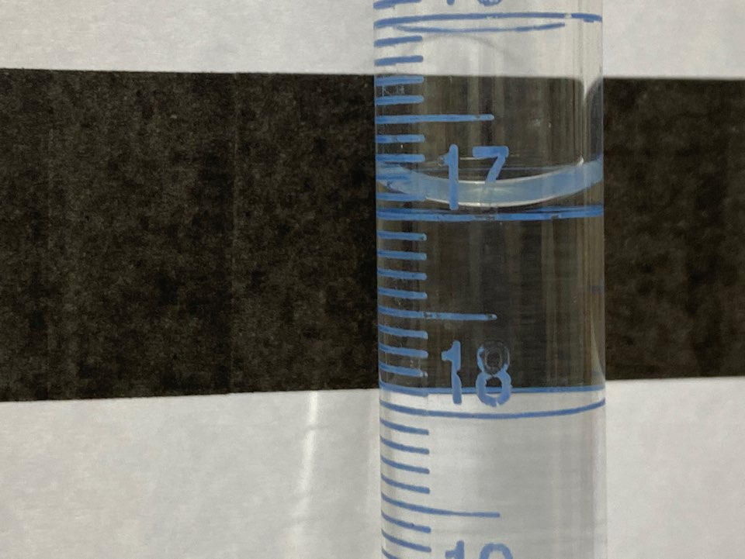
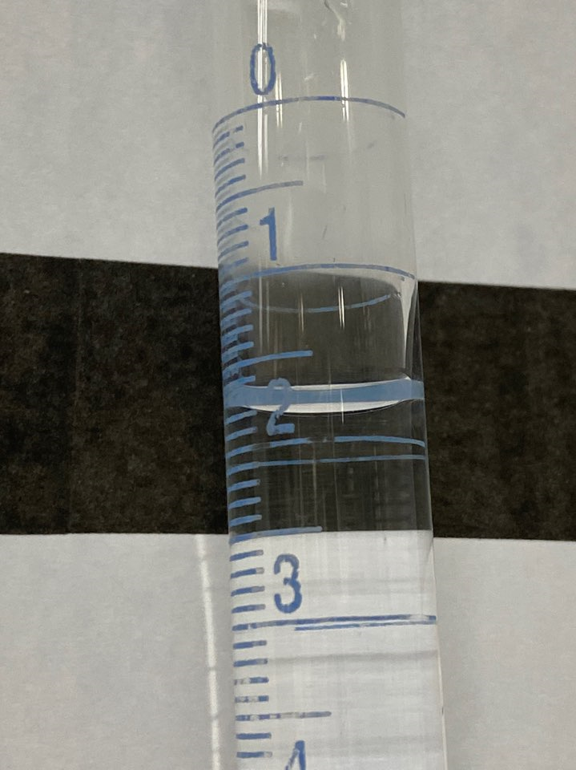
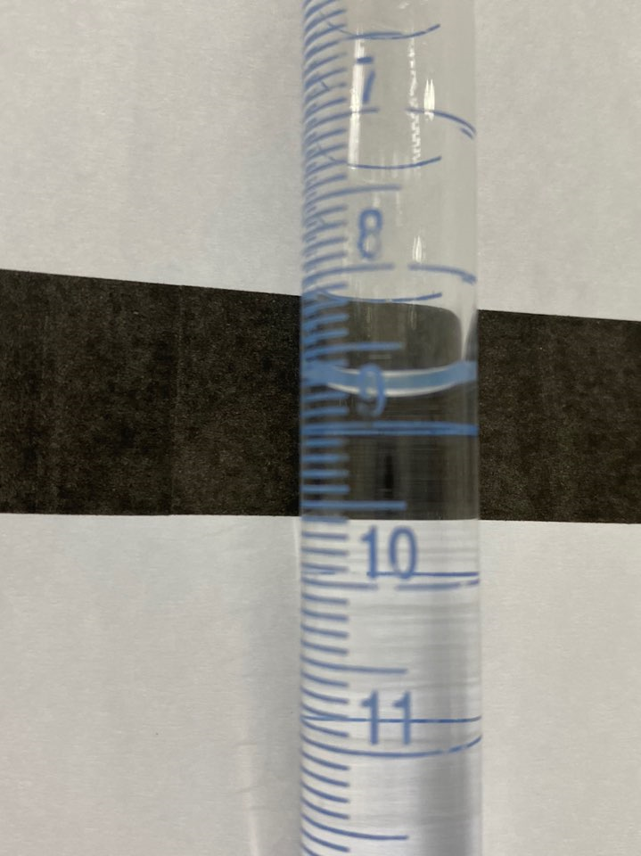
EXPERIMENTAL PROCEDURE & RESULT VIDEOS
Thermodynamics of the Dissolution of Borax
Analysis of Borax Test Solutions
Buret Reading, Initial & Final (mL)
Sample 1
Sample 2

Slide 11
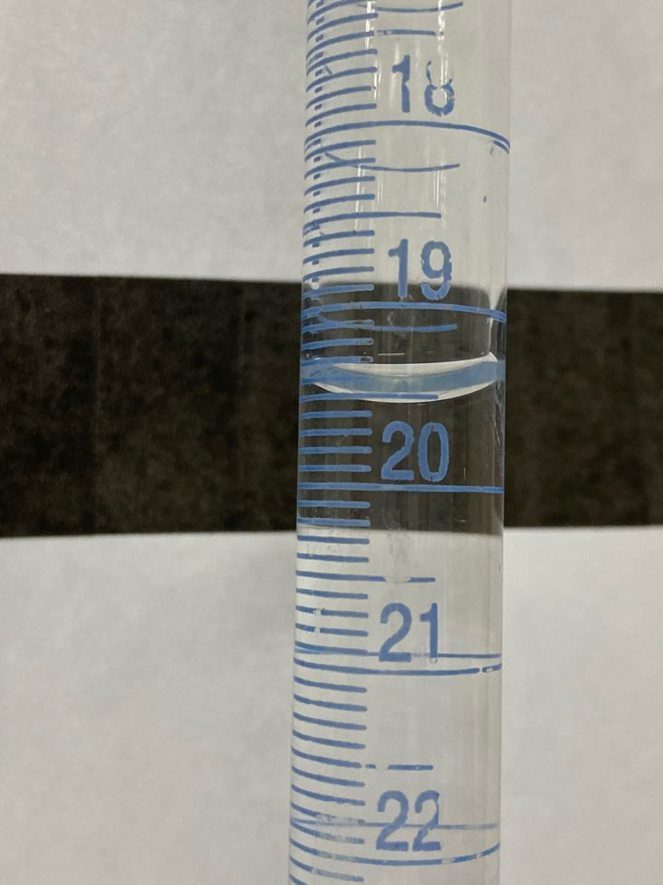
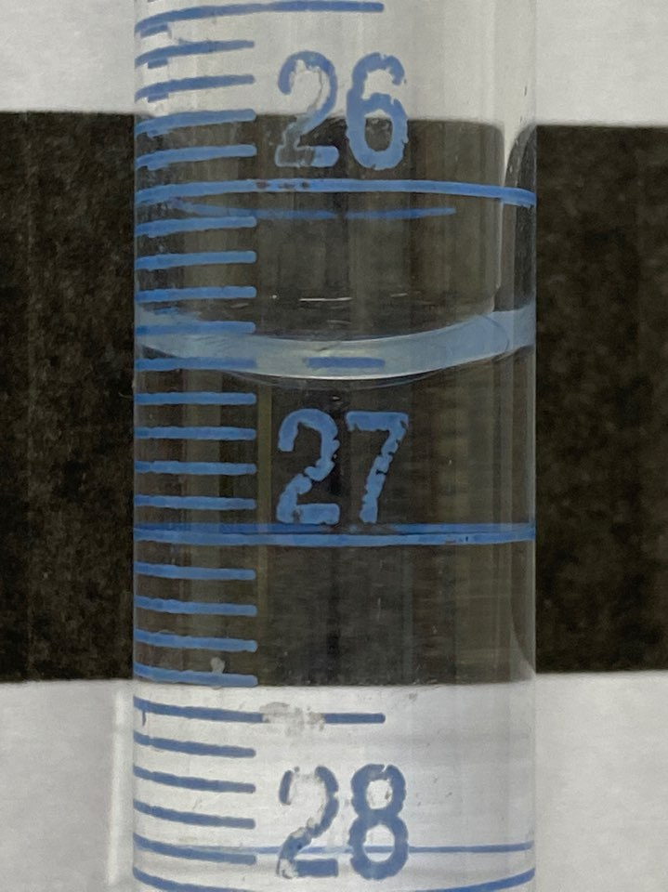
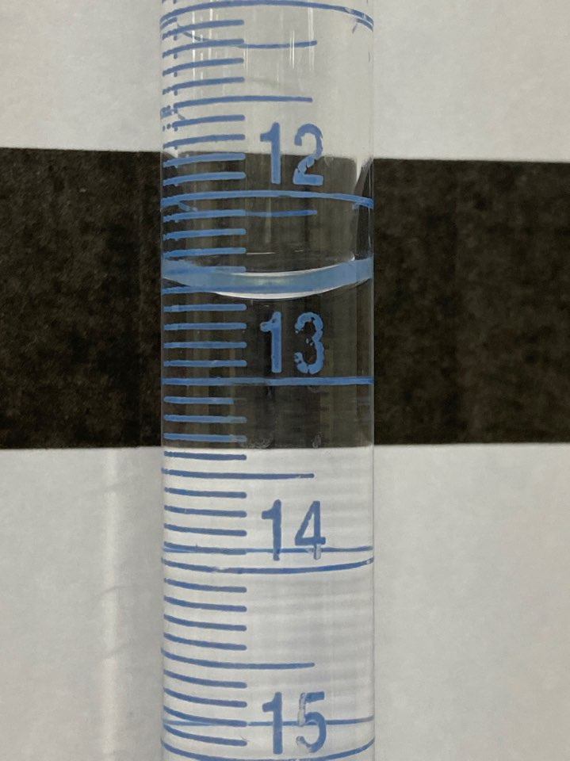
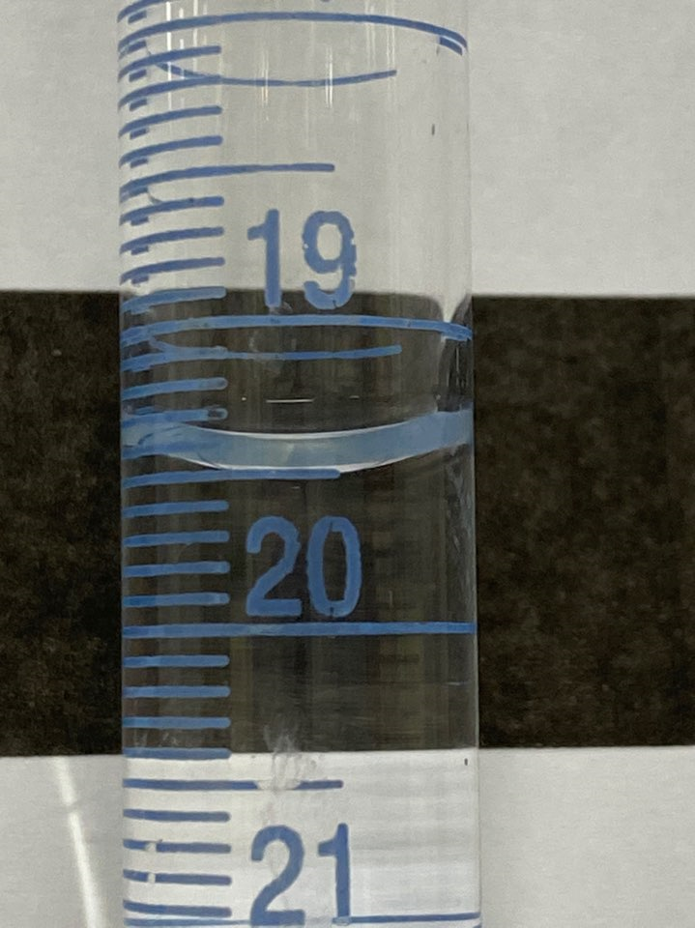
EXPERIMENTAL PROCEDURE & RESULT VIDEOS
Thermodynamics of the Dissolution of Borax
Analysis of Borax Test Solutions
Buret Reading, Initial & Final (mL)
Sample 3
Sample 4

Slide 12
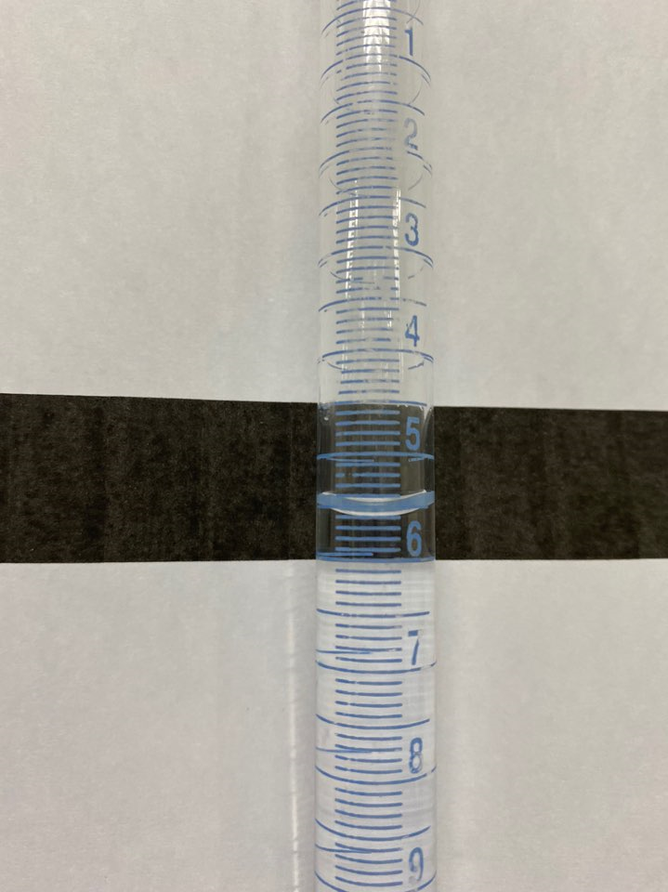
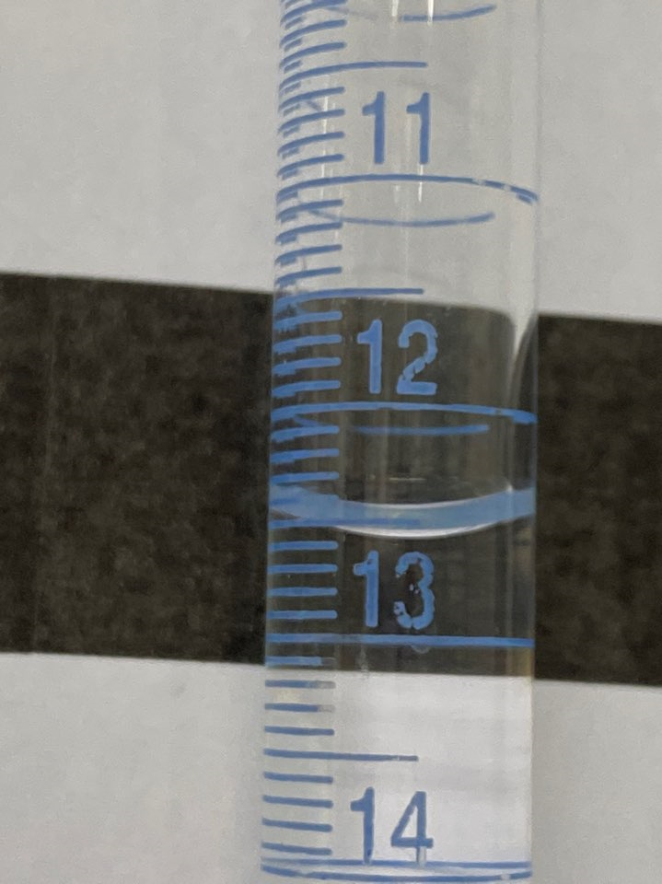
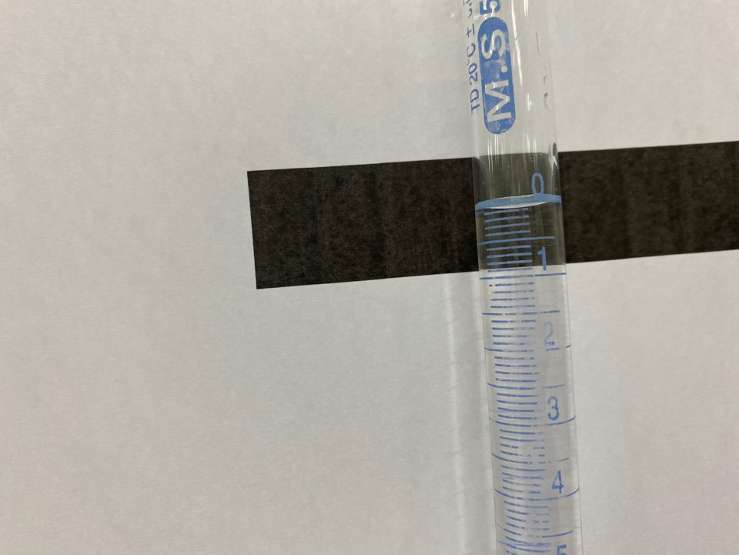
EXPERIMENTAL PROCEDURE & RESULT VIDEOS
Thermodynamics of the Dissolution of Borax
Analysis of Borax Test Solutions
Buret Reading, Initial & Final (mL)
Sample 5
Sample 6

